Slide 1
CSSE 332 Process
Thursday, December 6, 2018

Slide 2
Outline
Process overview
Process management
Process Control Block
Process State
Process scheduling
Scheduling queue
Process switch
Mode switch

Slide 3

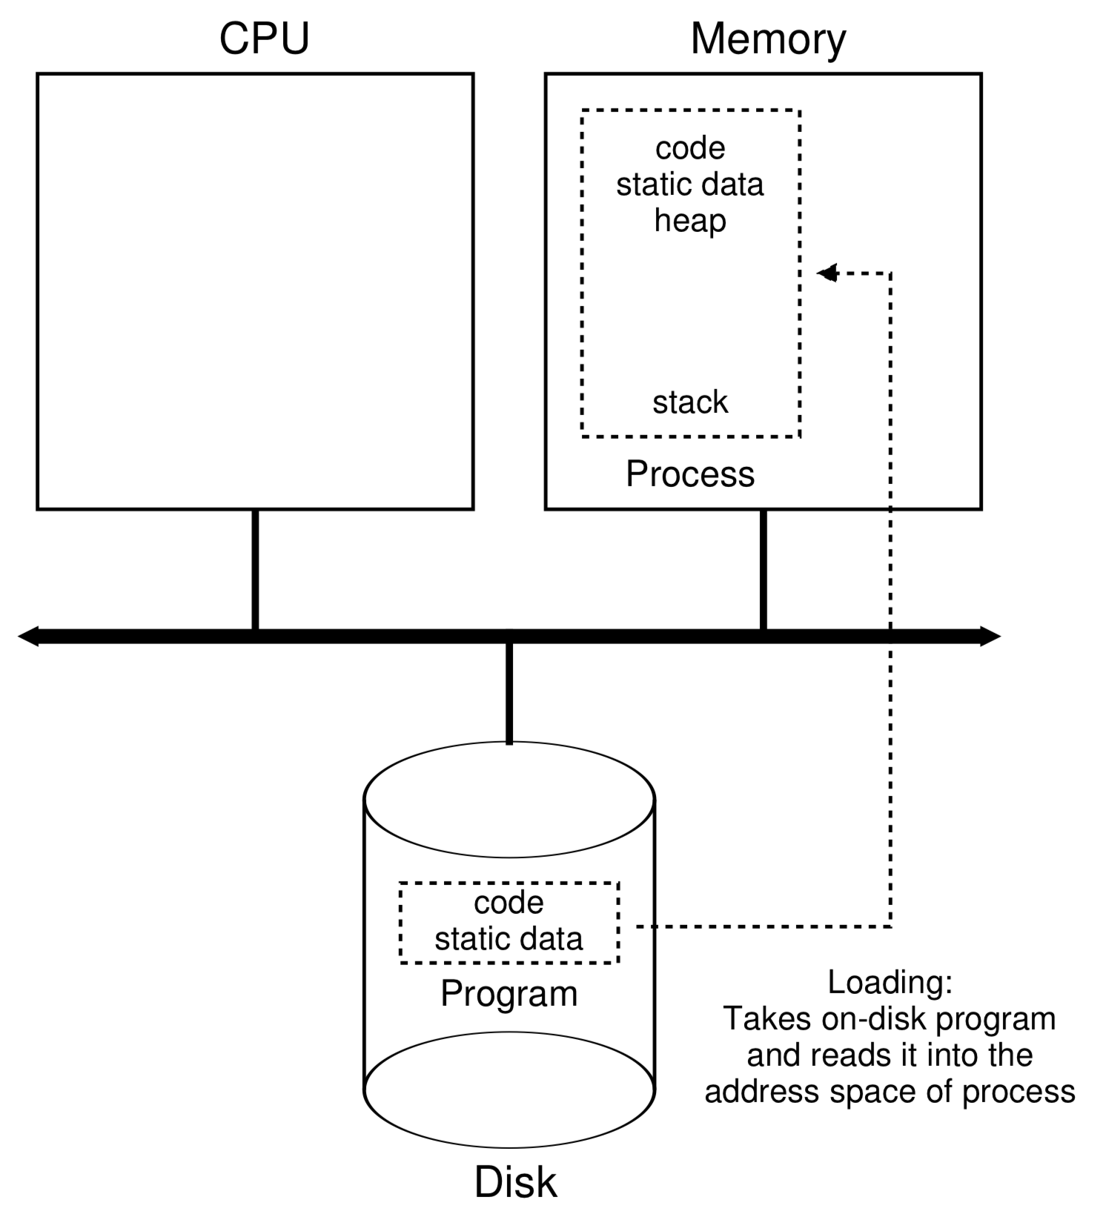
A program → a process
Double click the icon

Slide 4

Process: Context of Execution
A running programming; unit of allocation (resources, privileges)
Memory address space code, data, heap, stack
Kernel state Permissions, file descriptors, etc.
instruction context Program counter, stack pointer, data registers
Context of Execution
Adapted from Peter Bui @ND

Slide 5
Process: Data Structure
In Linux, there is a struct task_struct that represents each process:
Each process has a process control block (aka struct task_struct) that stores its information
Process list is a linked list that keeps track of all the processes
I planed to show you the source code of struct task_struct, but…..
The definition of the struct includes 634 lines of code.
Adapted from Peter Bui @ND

Slide 6
Process Control Block
Process state
Program counter
CPU registers
CPU scheduling information
Memory-management information
Accounting information
I/O status information
**Many modern OS’s expanded process concept to support multiple threads, so PCB can also include threads info.
More details: https://en.wikipedia.org/wiki/Process_control_block

Slide 7
Process: States
A live process can be in one of five states:
Terminated
New
Interrupt / Scheduling
Running
Ready
I/O Start
Blocked
I/O Done
Notes:
Use the functions in lab 1 to illustration

Slide 8
Process states
As a process executes, it changes state
New: The process is being created.
Ready: The process is waiting to be assigned to a processor.
Running: Instructions are being executed.
Waiting or blocked: The process is waiting for some event to occur.
Terminate or Exit: The process has finished execution.

Slide 9
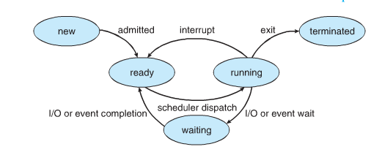
Process Scheduling Queues
Job queue – set of all processes in the system
Ready queue – set of all processes residing in main memory, ready and waiting to execute
Device queues – set of processes waiting for an I/O device
Processes migrate among the various queues

Slide 10
Process Scheduling
Objectives:
Multiprogramming
Share CPU time fairly
Process scheduler selects an available process (from ready queue) for execution on the CPU
Things to happen on CPU when the scheduler runs:
Process switch (context switch)
Mode switch

Slide 11
Process schedule example
Ready queue: P1 → P2 → P5
Disk queue: P3 → P6
Network I/O queue: P4 → P8
Running: P0
Ready queue: P0 → P3 →P2
Disk queue: P6
Network I/O queue:P4 → P8 → P1
Running: P5
?
P3 finishes disk access
P1 requests to access Network I/O
Time
T0
Process switch timer interruption

Slide 12
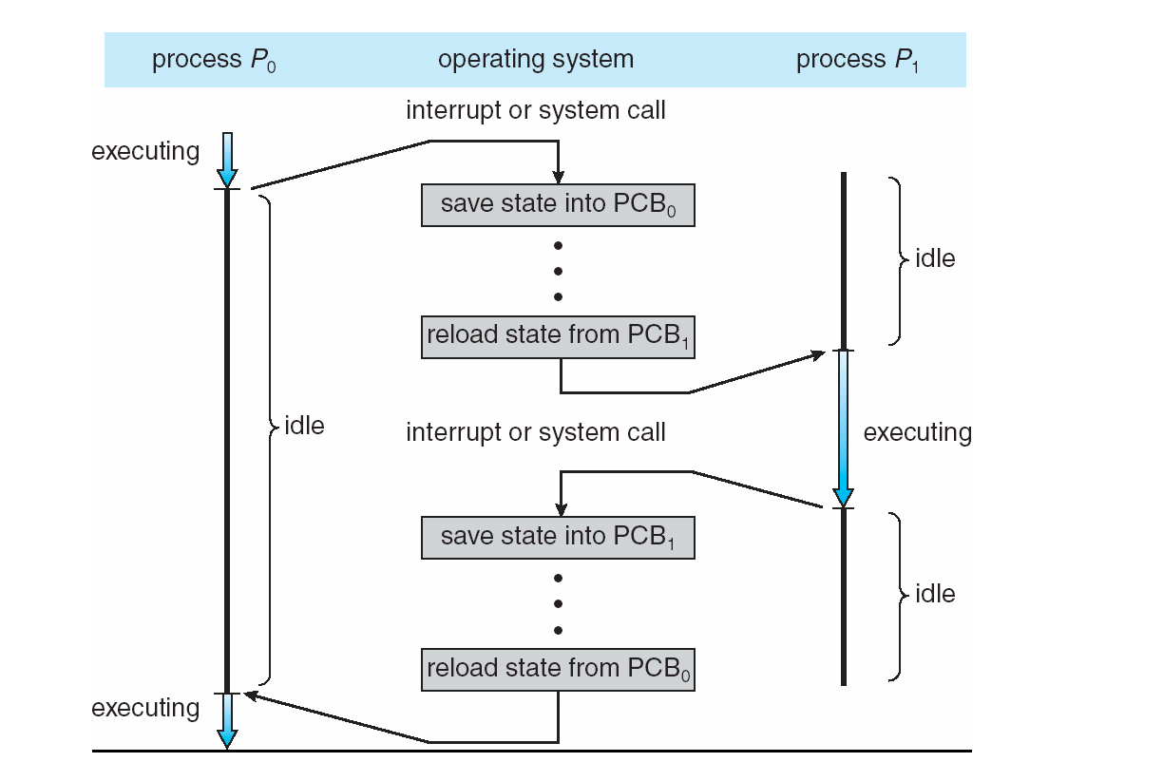
CPU Context Switch From Process to Process
Context-switch time is overhead; the system does no useful work while switching.
Time for context switch dependent on hardware support.
Notes:
Discuss here

Slide 13
CPU Mode Switch
Code that runs in user mode is restricted in what it can do.
In kernel mode mode, code that runs can do what it likes, including privileged operations such as issuing I/O requests and executing all types of restricted instructions.
If CPU needs to run OS code (system call), it has to switch to kernel mode.

Slide 14
Quiz
Complete the quiz on process state transition, process switch, and mode switch
Notes:
14

